Slide 1
Tutorial 3
TA Wu Yiheng Zhan, Zhanrui, Zhang Siyuan

Slide 2
Agenda
Assignment 2
Bezier
Bezier Curve
Tangent
Bezier Surface
Normal
Stitching
Sampling
Differential
Skeleton Code
Tea Party
Demo
Related Lecture : Lecture05

Slide 3
Assignment 2 Programming Requirements
Must
[ ] Implementation of the basic iterative de Casteljau Bézier vertex evaluation algorithm is required. (25% Must)
[ ] Construction of Bézier Surface with normal evaluation at each mesh vertex is required. (40% Must)
[ ] Rendering a Bézier Surface in a OpenGL window based on vertices array is required. (5% Must)
[ ] Tea party! Stitching multiple Bézier Surface patchs together to create a complex meshes is required. (20% Must)
Bonus
[ ] Adaptive mesh construction based on the curvature estimation. (15% Optional)
[ ] B-Spline / NURBS surfaces. (15% Optional)
[ ] Interactive editing (by selection) of control points. (15% Optional)
[ ] Make a Cut! Cut the bezier surface with a plane. (30% Optional)

Slide 4
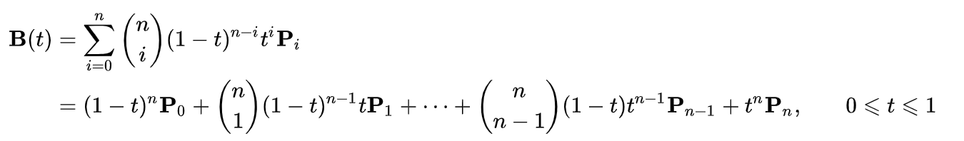
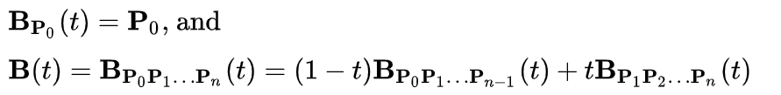
Bézier Curve
Explicit definition
Recursive definition

Slide 5
Bézier Curve
Evaluation
A simple way: Compute each term in the explicit defination
numerical errors
De Casteljau's Algorithm
Fast and stable
[√] Implementation of the basic iterative de Casteljau Bézier vertex evaluation algorithm is required. (25% Must)

Slide 6
Bézier Curve
Tangent

Slide 7
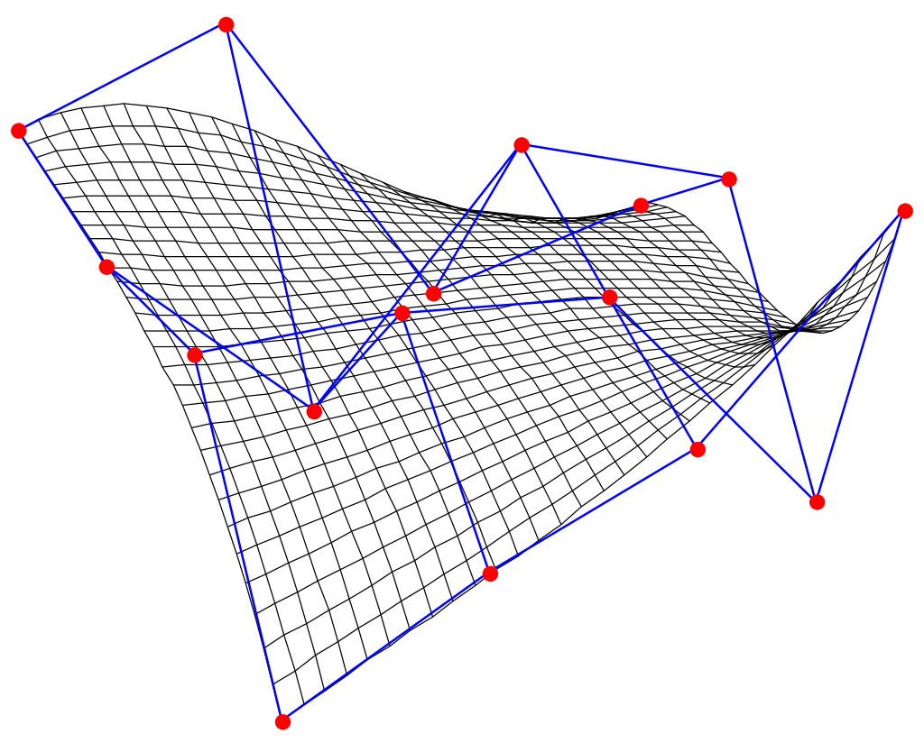
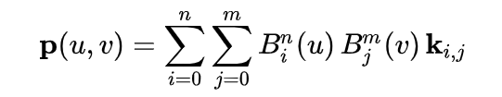
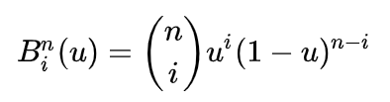
Bézier Surface
Bernstein polynomial

Slide 8
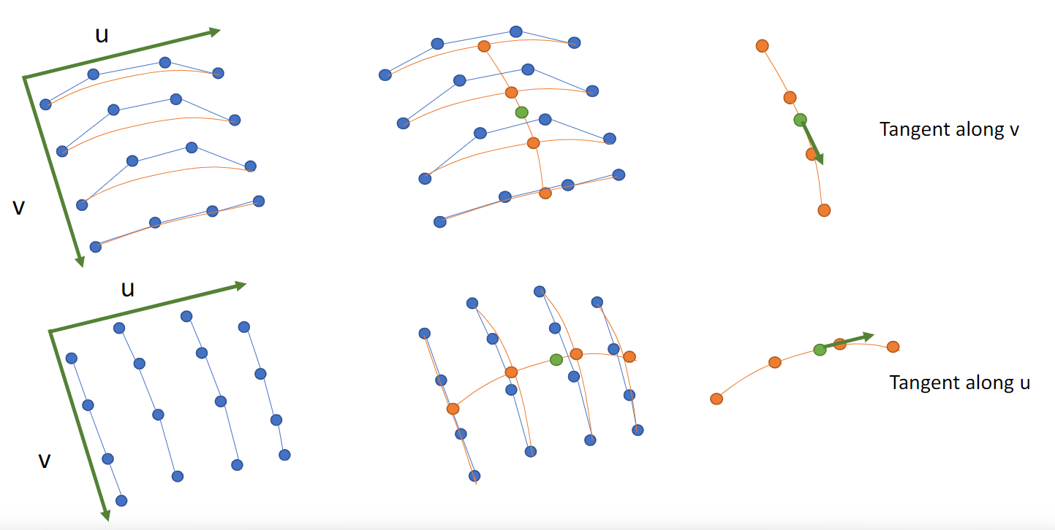
Bézier Surface
Evaluation

Slide 9
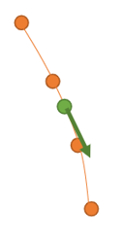
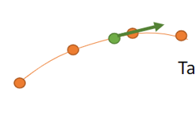

Bézier Surface
Normal
Surface normal:

Slide 10
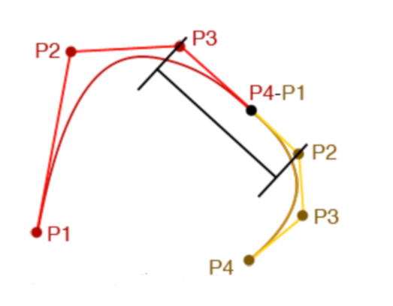
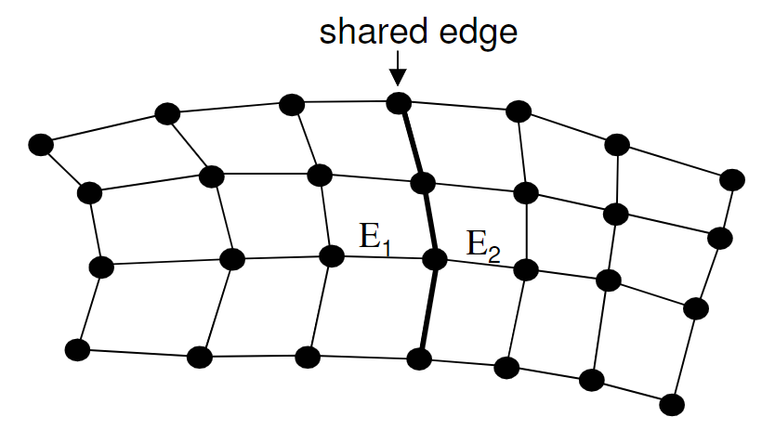
Bézier Surface
Stitching
For continuity of slope across two stitched patches, require:
Identical control points along common edge curves (0-order continuity)
Identical slopes of orthogonal control curves (1st -order continuity)
Co-linearity of control mesh edges that meet at a common edge control point, e.g. E1 and E2 (called geometric continuity), or
Equality of edge vectors(called parametric continuity)
Notes:
对于跨越两个缝合补丁的坡度的连续性，要求。
沿着共同的边缘曲线有相同的控制点（0阶连续性）。
正交控制曲线的坡度相同（1阶连续性）。
在一个共同的边缘控制点相遇的控制网边缘的共线性，如E1和E2（称为几何连续性），或
边缘向量的平等性(称为参数连续性)

Slide 11
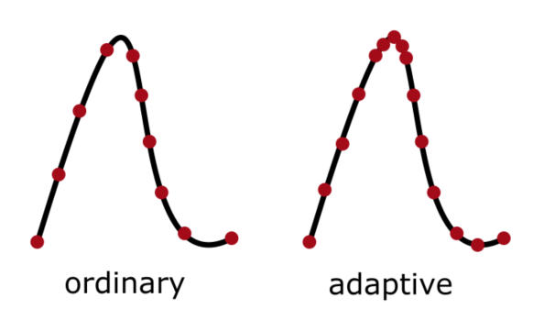
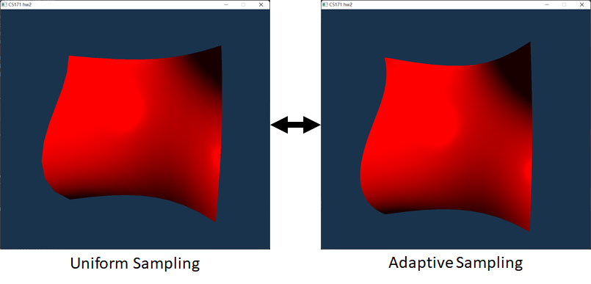
Bézier Surface
Sampling
Curvature?
Deflection?
Length?

Slide 12
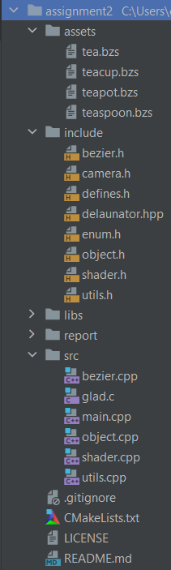
Skeleton Code
bezier.h/.cpp Implements of generate mesh from Bezier Control Points.
object.h/.cpp Implements of draw mesh in OpenGL.

Slide 13
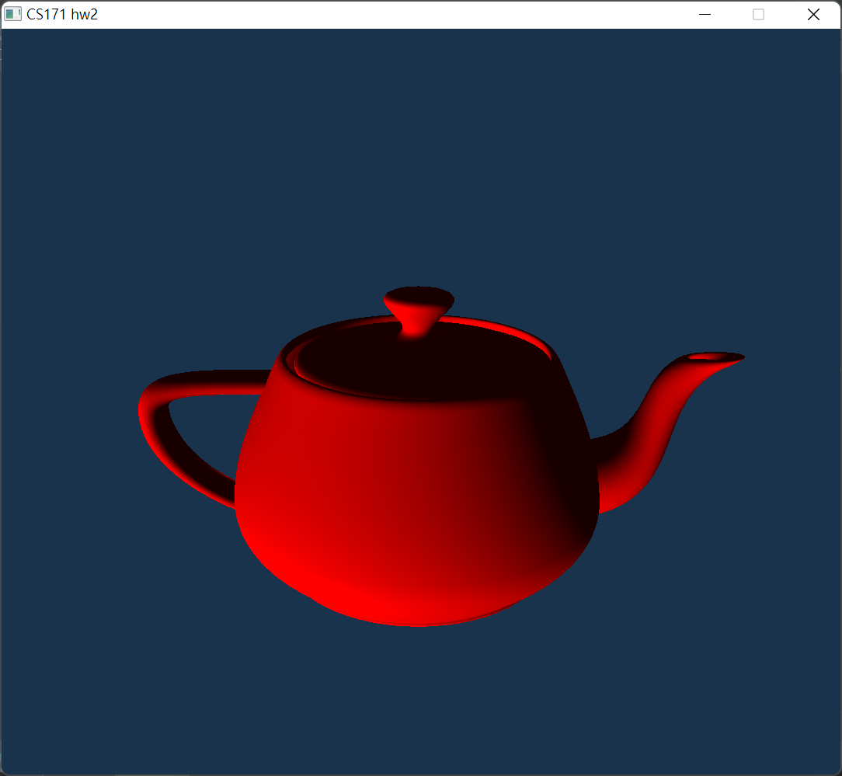
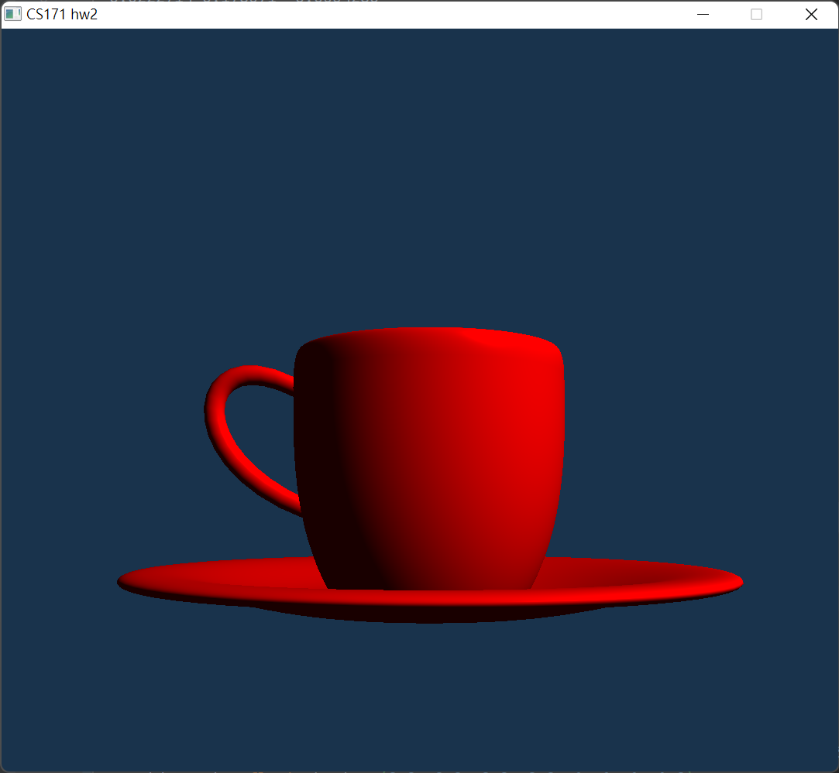
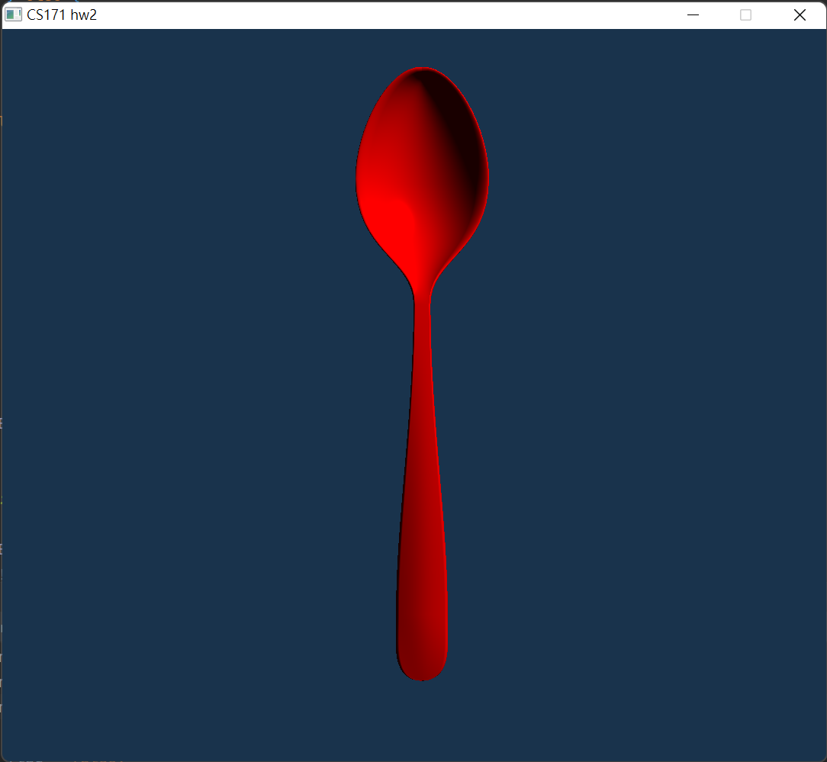
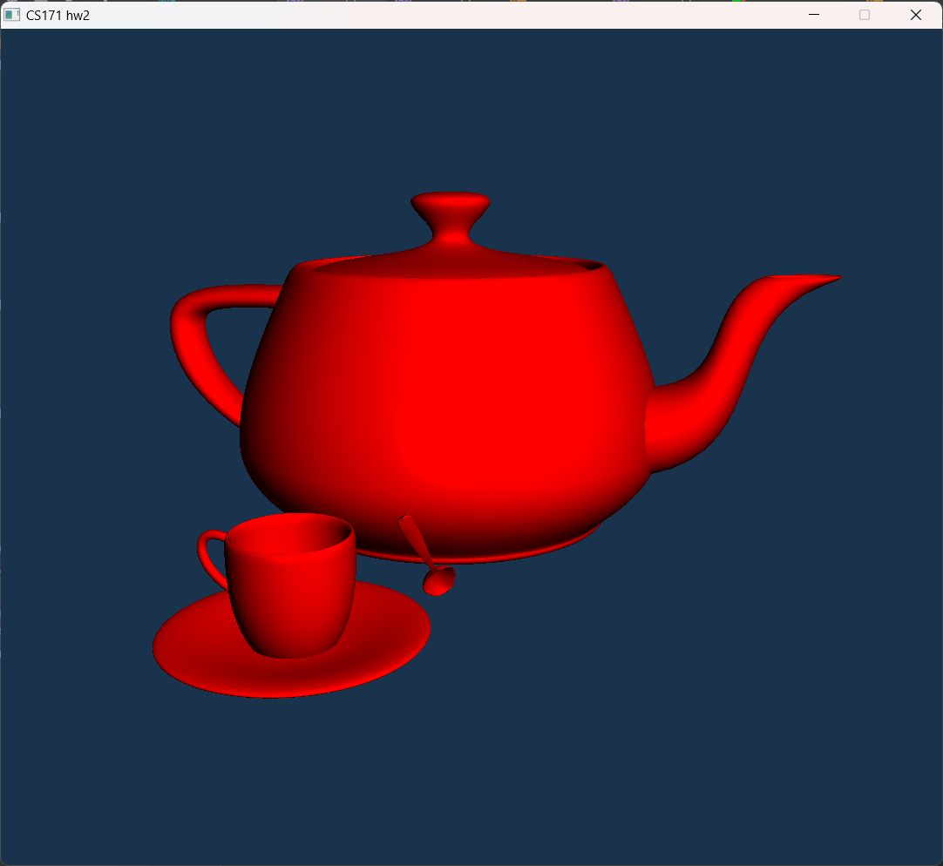
Tea Party
b represents for number of Bezier Surface, p represents for control points number, m and n represents for the Bezier Surface’s control point row number and column number. For the next b lines, each line includes m \times n integers ranging from 0 to b-1 telling the index of the control points of a single bezier surface. For the last p liens, each line have three float number telling the position of control points. we have offered teacup, teapot and teaspoon’s bezier surface file separately and a tea_party.bzs file putting them together.
teaspoon.bzs
16 148 4 4 0 1 1 2 3 4 5 6 7 8 9 10 11 12 13 14 … 111 116 117 90 138 143 144 118 141 145 146 122 142 142 147 126 -0.000107143 0.205357 0.0 0.0 0.196429 -0.0178571 ….

